Slide 1
IMPROVEMENT IN SELECTION OF REFRIGERANTS
DONE BY: ANIKETH CHANDRASHEKHAR LOLAM, VARUN SUBRAMANIAN, SANDEEP RAMESH MOUDGALYA,
NIRIKSHITH VENUGOPAL & HRISHIKESH RAO.
depends on
Selection of refrigerants depends on Degrees of freedom of refrigerant.
increase in overall efficiency of the system
Selection of a better refrigerant
cost savings

Slide 2
REFRIGERATIONS UNDER CONSIDERATIONS
REFRIGERANT | R1234yf | R1234ze | R452b | R32
IUPAC Nomenclature | 2,3,3,3-Tetrafluoropropene | 1,3,3,3-Tetrafluoropropene | - | Difluoromethane
Chemical Formula | C₃H₂F₄ | C₃H₂F₄ | 67 %/7 %/26 % R-32/R-125/R-1234yf | CH₂F₂
Boiling Point (°C) | -30 | -19 | -51 | -52
Vapor Pressure | 6.067 kPa (at 21.1°C) | 703 kPa (at 37°C) | 1537.4 kPa (at 25°C) | 1518.92 kPa (at 21.1°C)
References:
https://en.wikipedia.org/wiki/2,3,3,3-Tetrafluoropropene
https://en.wikipedia.org/wiki/1,3,3,3-Tetrafluoropropene
https://en.wikipedia.org/wiki/Difluoromethane

Slide 3
SYSTEM CONDITIONS FOR ANALYSIS
Taking into consideration a 10-ton refrigeration unit with single-staged actual vapor cycle with the following conditions:
Pressure drop inside Evaporator is 5psia
Evaporator output conditions: Temperature is 40F and saturated vapor.
Pressure drop inside suction valve is 2psia & vapor is superheated by 20F
Compressor Discharge Pressure is 300psia
Pressure drop inside discharge valve is 5psia & vapor is de-superheated by 10F
Pressure drop inside condenser is 5psia
Expansion valve input conditions: Pressure is 290psia & Temperature is 110F

Slide 4
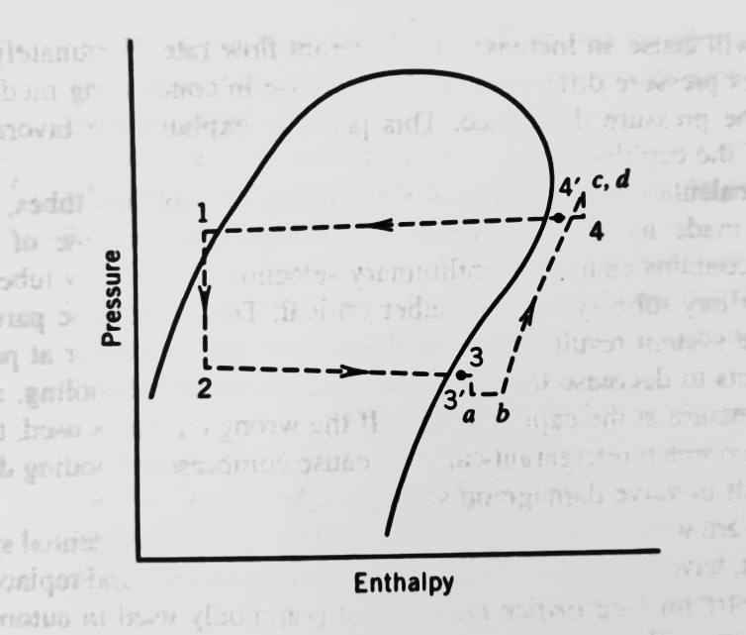
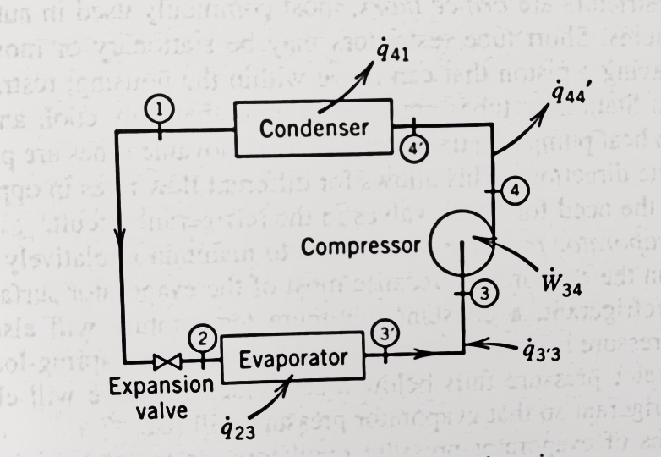
ACTAUAL SINGLE-STAGED VAPOR COMPRESSSION CYCLE
Pressure-Enthalpy (P-H) Diagram
Single-Staged Vapor Compression Cycle

Slide 5
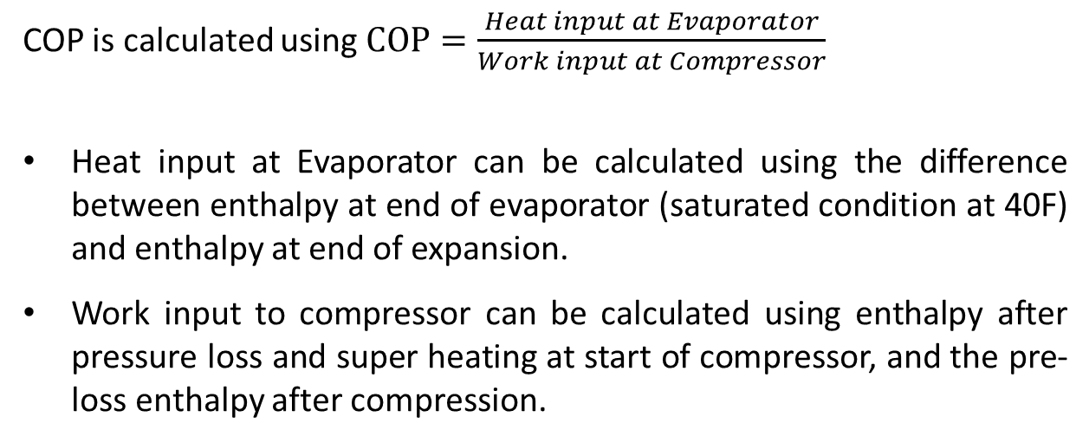
Calculating COP
COP is calculated using $COP=\frac{Heat input at Evaporator}{Work input at Compressor}$
Heat input at Evaporator can be calculated using the difference between enthalpy at end of evaporator (saturated condition at 40F) and enthalpy at end of expansion.
Work input to compressor can be calculated using enthalpy after pressure loss and super heating at start of compressor, and the pre-loss enthalpy after compression.

Slide 6
PROPERTIES OF NEXT-GEN REFRIGERANTS
Refrigerant | R1234yf | R1234ze | R452b | R32
Cost per pound | $50 | $50 | Approx. $50-$60 | $11
Usage in Industry | Currently in Automobiles only | Currently in Automobiles only | Direct expansion (DX) chillers, High pressure heat pumps | AC systems and Heat Pumps
COP | 5.57 | 4.33 | 5.72 | 4.55
GWP | Less than 1 | Less than 1 | 675 | 675
Ozone Depletion | Zero | Zero | Zero | Zero

Slide 7
COMPARISON BETWEEN Current and New refrigerants
Refrigerant | R134a | R1234yf
Cost per pound | $16 | $50
Usage in Industry | Highly Used | Currently in Automobiles only
COP | 5.38 | 5.57
GWP | 1430 | Less than 1
Ozone Depletion | Zero | Zero
References:
https://www.amazon.com/DuPont-Suva-R-134a-Refrigerant-12oz/dp/B001CUNFGI/ref=sr_1_5?keywords=r-134a+cans&linkCode=sl2&linkId=18f0563028c5c0b1de47680d7efe0452&qid=1575324752&sr=8-5
https://www.amazon.com/HFO-1234YF-Case-Cans-8-Ounce-each/dp/B01M3YQ8Z9/ref=pd_bxgy_328_img_3/145-9857952-0726501?_encoding=UTF8&pd_rd_i=B01M3YQ8Z9&pd_rd_r=876446ac-033a-4549-b7dc-d9e6792a5584&pd_rd_w=285fd&pd_rd_wg=dIAw5&pf_rd_p=09627863-9889-4290-b90a-5e9f86682449&pf_rd_r=5K519AZSWFCRATXPRR4Z&psc=1&refRID=5K519AZSWFCRATXPRR4Z

Slide 8
COMPARISON BETWEEN Current and New refrigerants
Refrigerant | R134a | R1234ze
Cost per pound | $16 | $50
Usage in Industry | Highly Used | Currently in Automobiles only
COP | 5.38 | 4.33
GWP | 1430 | Less than 1
Ozone Depletion | Zero | Zero
References:
https://www.amazon.com/DuPont-Suva-R-134a-Refrigerant-12oz/dp/B001CUNFGI/ref=sr_1_5?keywords=r-134a+cans&linkCode=sl2&linkId=18f0563028c5c0b1de47680d7efe0452&qid=1575324752&sr=8-5
https://www.amazon.com/HFO-1234YF-Case-Cans-8-Ounce-each/dp/B01M3YQ8Z9/ref=pd_bxgy_328_img_3/145-9857952-0726501?_encoding=UTF8&pd_rd_i=B01M3YQ8Z9&pd_rd_r=876446ac-033a-4549-b7dc-d9e6792a5584&pd_rd_w=285fd&pd_rd_wg=dIAw5&pf_rd_p=09627863-9889-4290-b90a-5e9f86682449&pf_rd_r=5K519AZSWFCRATXPRR4Z&psc=1&refRID=5K519AZSWFCRATXPRR4Z

Slide 9
COMPARISON BETWEEN Current and New refrigerants
Refrigerant | R410a | R452b
Cost per pound | $5.8 | Approx. $50-$60
Usage in Industry | Used in several industries | Direct expansion (DX) chillers, High pressure heat pumps
COP | 4.83 | 5.72
GWP | 2,088 | 675
Ozone Depletion | Zero | Zero
References:
https://www.amazon.com/DuPont-Suva-R-134a-Refrigerant-12oz/dp/B001CUNFGI/ref=sr_1_5?keywords=r-134a+cans&linkCode=sl2&linkId=18f0563028c5c0b1de47680d7efe0452&qid=1575324752&sr=8-5
https://www.amazon.com/HFO-1234YF-Case-Cans-8-Ounce-each/dp/B01M3YQ8Z9/ref=pd_bxgy_328_img_3/145-9857952-0726501?_encoding=UTF8&pd_rd_i=B01M3YQ8Z9&pd_rd_r=876446ac-033a-4549-b7dc-d9e6792a5584&pd_rd_w=285fd&pd_rd_wg=dIAw5&pf_rd_p=09627863-9889-4290-b90a-5e9f86682449&pf_rd_r=5K519AZSWFCRATXPRR4Z&psc=1&refRID=5K519AZSWFCRATXPRR4Z

Slide 10
COMPARISON BETWEEN Current and New refrigerants
Refrigerant | R410a | R32
Cost per pound | $5.8 | $11
Usage in Industry | Used in several industries | AC Systems and Heat Pumps
COP | 4.83 | 4.55
GWP | 2,088 | 675
Ozone Depletion | Zero | Zero
References:
https://www.amazon.com/DuPont-Suva-R-134a-Refrigerant-12oz/dp/B001CUNFGI/ref=sr_1_5?keywords=r-134a+cans&linkCode=sl2&linkId=18f0563028c5c0b1de47680d7efe0452&qid=1575324752&sr=8-5
https://www.amazon.com/HFO-1234YF-Case-Cans-8-Ounce-each/dp/B01M3YQ8Z9/ref=pd_bxgy_328_img_3/145-9857952-0726501?_encoding=UTF8&pd_rd_i=B01M3YQ8Z9&pd_rd_r=876446ac-033a-4549-b7dc-d9e6792a5584&pd_rd_w=285fd&pd_rd_wg=dIAw5&pf_rd_p=09627863-9889-4290-b90a-5e9f86682449&pf_rd_r=5K519AZSWFCRATXPRR4Z&psc=1&refRID=5K519AZSWFCRATXPRR4Z

Slide 11
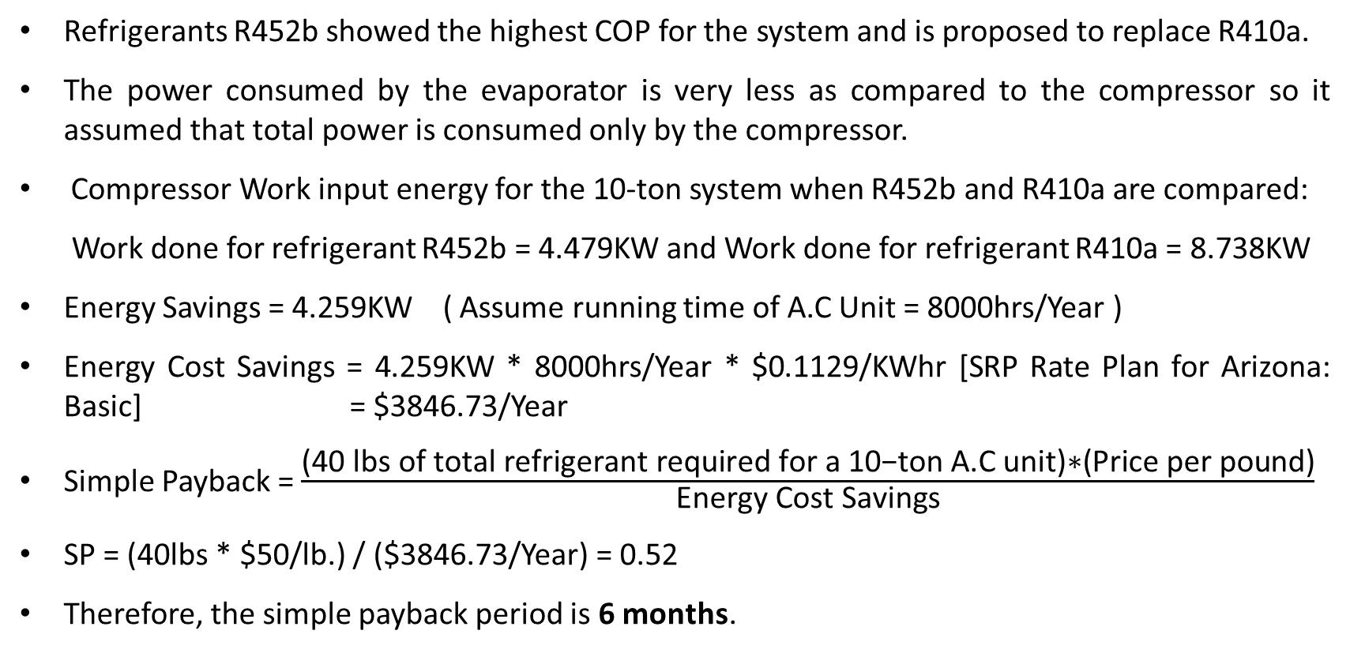
SIMPLE PAYBACK ANALYSIS
Refrigerants R452b showed the highest COP for the system and is proposed to replace R410a.
The power consumed by the evaporator is very less as compared to the compressor so it assumed that total power is consumed only by the compressor.
Compressor Work input energy for the 10-ton system when R452b and R410a are compared:
Work done for refrigerant R452b = 4.479KW and Work done for refrigerant R410a = 8.738KW
Energy Savings = 4.259KW ( Assume running time of A.C Unit = 8000hrs/Year )
Energy Cost Savings = 4.259KW * 8000hrs/Year * $0.1129/KWhr [SRP Rate Plan for Arizona: Basic] = $3846.73/Year
Simple Payback = $\frac{\text{(40 }\text{lbs} \text{of} \text{total} \text{refrigerant} \text{required} \text{for} \text{a}\text{ 10−}\text{ton} \text{A}\text{.}\text{C} \text{unit}\text{)∗(}\text{Price} \text{per} \text{pound}\text{)}}{\text{Energy} \text{Cost} \text{Savings}}$
SP = (40lbs * $50/lb.) / ($3846.73/Year) = 0.52
Therefore, the simple payback period is 6 months.
References:
https://www.electricitylocal.com/states/arizona/

Slide 12
References
https://www.honeywell-refrigerants.com/europe/product/solstice-l41y/
https://les.mitsubishielectric.co.uk/the-hub/whychangetor32
https://www.kaltra.com/r-452b
https://www.airconditioning-systems.com/R32.html
https://www.srpnet.com/prices/home/basic.aspx

Slide 13
THANK YOU

